Slide 1
Fall 2021 Pre-calculus
Lesson 5.2
Dr. O’Brien
Lehman High School
October 19, 2021
Notes:
students need calculators
no new vocab

Slide 2
do now
be sure to: Get out your binder. Copy goal and answer do now questions below. Show all work or write a complete sentence for each answer:
What’s the parent function for $f(x)$?
How’s $f(x)$ being transformed from its parent function?
Sketch a graph for $f(x)$.
$$f(x)=(x+2)^{2}+3$$
Notes:
The basic quadratic is x**2.
It’s being shifted 3 right and 2 up.
Sketch on board. Upward facing with vertex at (3,2)

Slide 3
framing
what: write quadratic equations in standard form
why: The quadratic equation can be used to model things in science, engineering, and more!
where to: Identifying x-intercept of a quadratic
Notes:
the plan: We’ll go through one of the Pset #5 word problems together.
You’ll work with a partner to solve some other word problems

Slide 4
Vocabulary
Vertex: Minimum or maximum point of a quadratic function

Slide 5
definition of quadratic function
Let a, b, and c be real numbers with $a≠0$. The function:
$$f(x)=ax^{2}+bx+c$$
is called a quadratic function.
Notes:
Write in notes.

Slide 6
Example
Trajectory of a rocket :
$$h(x)=16t^{2}+256t+4$$
Notes:
Draw picture on board, h(x) is the height of the rocket at any time t

Slide 7
The problem
If you write your equation like this:
$$f(x)=ax^{2}+bx+c$$
How can you figure out how it’s being shifted from the parent function?
Notes:
In other words how do we identify the vertex?

Slide 8
$$f(x)=x^{2}+4x+7$$
Notes:
How can we rewrite this in a form where we can identify the vertex?
f(x) = 2x2 + 8x + 7
f(x) = 2(x**2 + 4x) + 7
Use box method to show x sq plus 4x is part of x**2 + 4x + 4 -4)
= (x +2)**2 + 3
This is the same as the equation from the do now

Slide 9
standard form for quadratic equation
$$f(x)=a(x-h)^{2}+k$$
Notes:
(h,k) denotes the vertex
If a is less than 0 frown
If a is > 0 smile!

Slide 10
Another example
$$g(x)=2x^{2}+8x-9$$

Slide 11
Problem set
Be sure to:
Work at a volume 0 first 4 minutes
Then you can check in with a neighbor
Do work in your notebook
Show all work

Slide 12
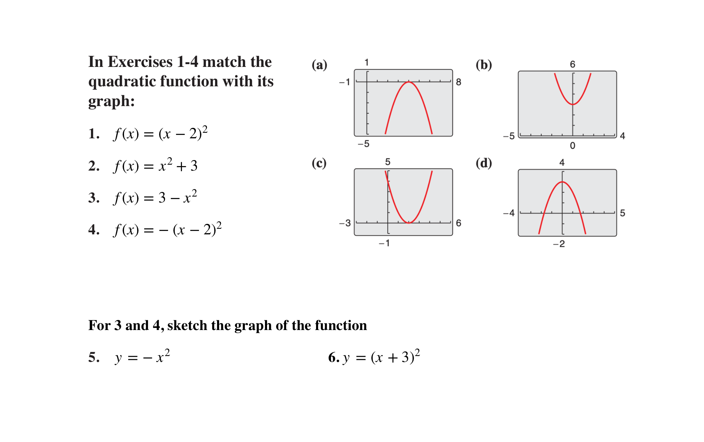

Slide 13
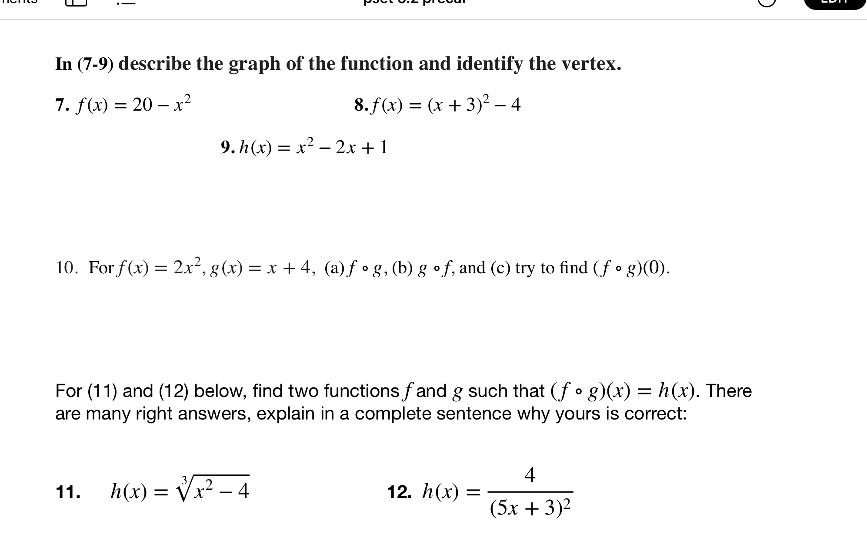
Notes:
+how rewrite in standard form?check notes!
How identify composite functions? Find a simpler function in the bigger one

Slide 14
d
exit ticket
be sure to: Answer on a sheet of loose leaf paper. Show all work or write a complete sentence for each answer:
Rewrite $h(x)=x^{2}-2x+1$ in standard form.
Sketch a graph for the equation, identifying the vertex.
Notes:
(x^2 - 2x - 1) + 1 + 1
(x - 1)^2 + 2
vertex = (1,2)
2. sketch an upward facing quadratic with vertex at (1,2).

